Slide 1



AUTONOMOUS SHIPPING Sprint 4
Jasper Vlaar, Jelte Molenaar, Job Vink, Michiel van Soest en Martin de Rijke

Slide 2
Topics
Innovation expo
Demo
Opportunities
Research Paper
Structure
Responsibilities

Slide 4
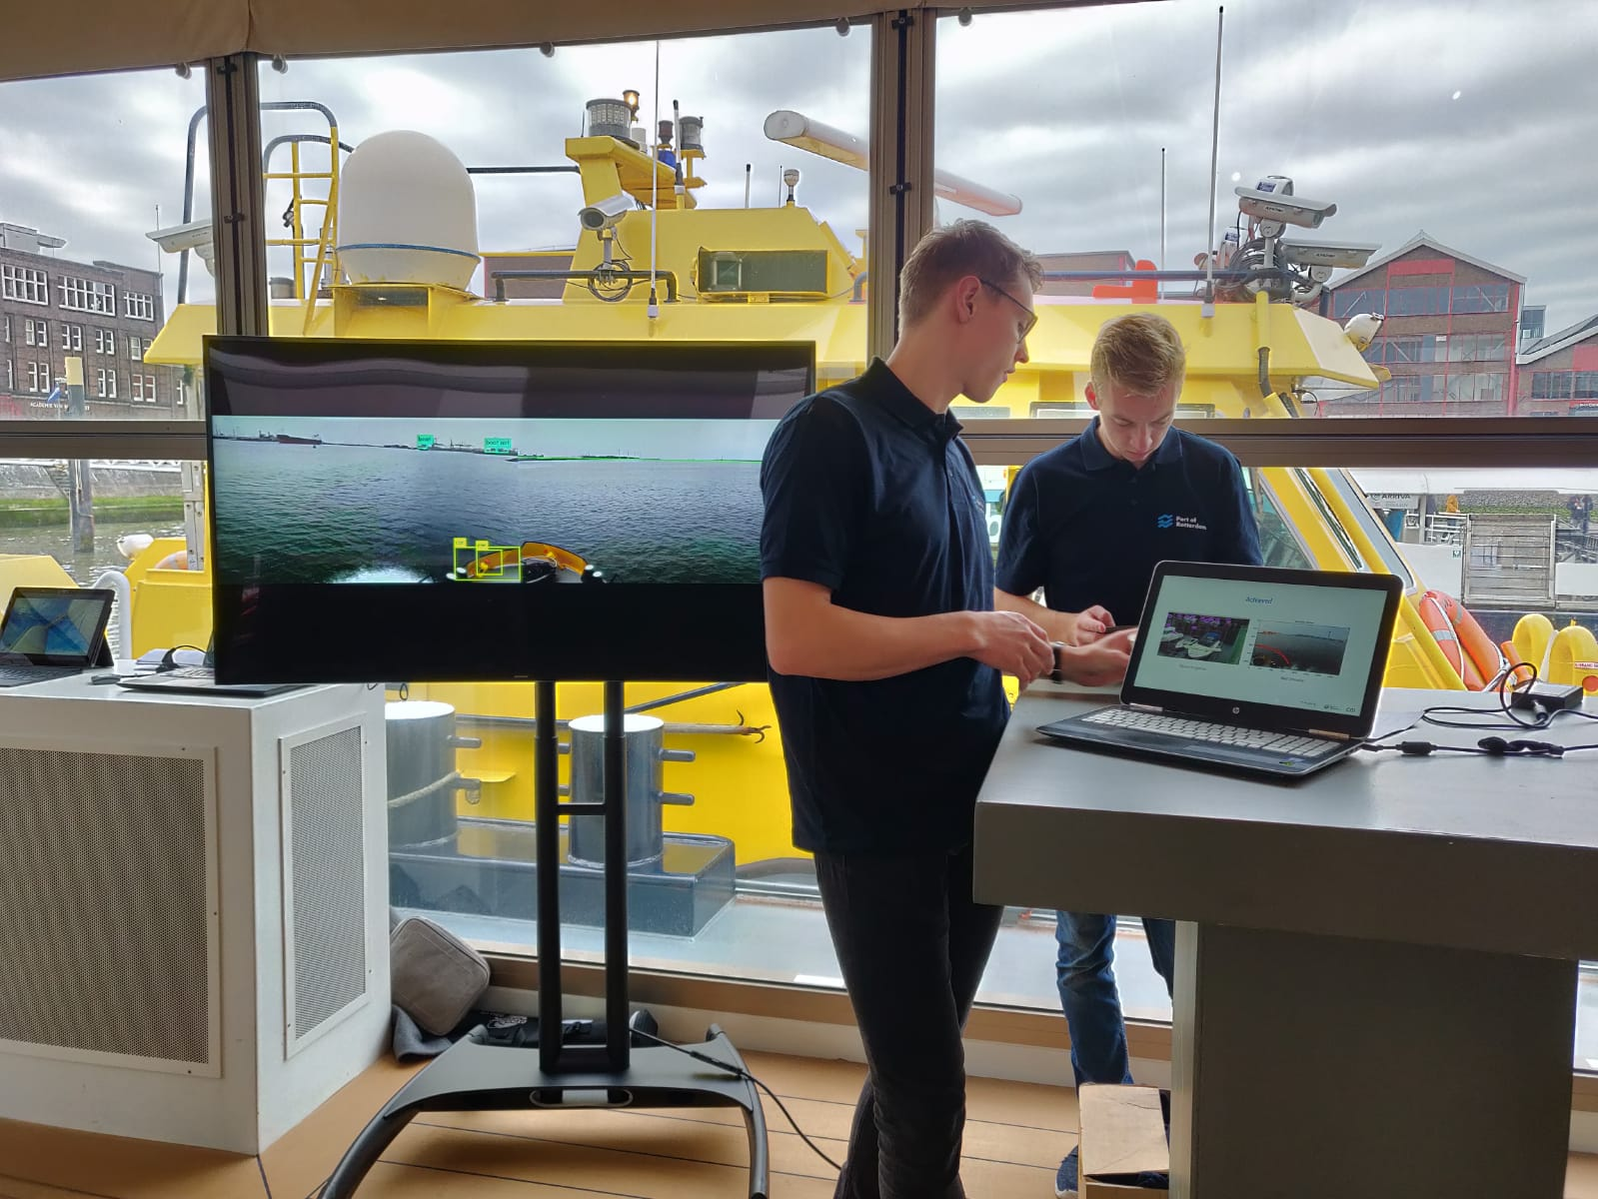
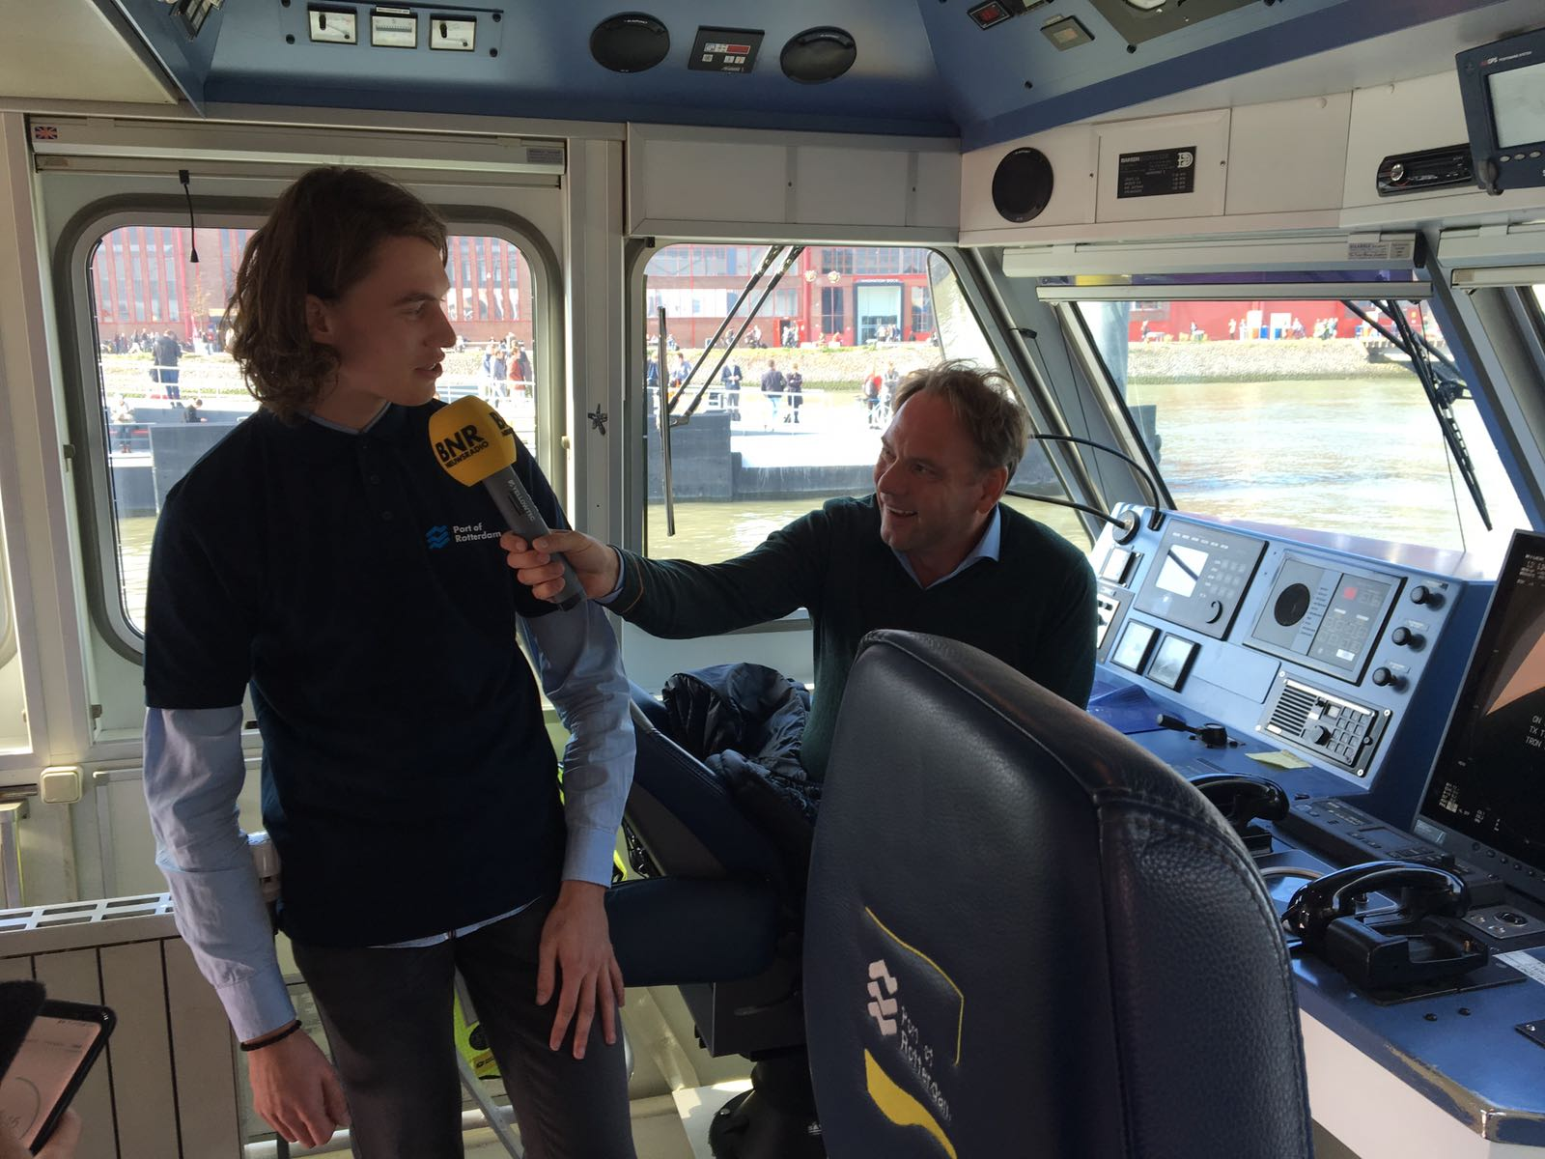
Innovation Expo

Slide 5
Research Paper
Comparison
Responsibilities
Academic

Slide 6
RELATED WORK
SMART SHIPPING
DETECTION METHOD
OBJECT RECOGNITION
SHORE DETECTION
DISTANCE CAMERAS
THEORY
EXPIRIMENT

Slide 7
Next?
Perfection
Verification Algorithm

